Slide 1
Log-based Anomaly Detection and Tracing back to Phishing Emails
學生：
0716008 呂沛儒
0716058 王玉心
0716203 黃子潔
指導教授：
謝續平

Slide 2
Outline
Introduction
Our Solution
Attack Emulation
Design and Implementation
Detection from System Logs
Detection from Network Logs
Log Traceback
Evaluation
Conclusion & Contribution
Notes:
這是我們報告的大綱，首先會介紹動機，接著說明攻擊、偵測和traceback，最後是結論和貢獻。

Slide 3
Introduction
An APT attack consists of various tactics, including initial access, credential access, and command and control
DoppelPaymer is a ransomware that launch their attacks from 2019 to now, threatening victims after stealing their files
The techniques used in their attack may include phishing emails
Since it is hard to detect this kind of attack behavior with antivirus, finding other detection method is an essential issue currently
Notes:
我先說明我們研究的動機。APT攻擊使用許多tactic來達成長期攻擊，包括initial access、credential access和command and control等。例如勒索軟體DoppelPaymer從2019年到現在透過這種攻擊手法竊取檔案並威脅受害者，他們在一些案例中可能使用到phishing emails等technique，這些攻擊行為很難用防毒軟體偵測，因此找出有效的偵測方式是現在重要的議題。

Slide 4
Our Solution
Solution to the problem
Machine learning models for anomaly detection from logs
Tracing the logs for connecting the whole attack process
We propose a log-based framework which
Detect anomalous activities from system logs and network logs
Trace back to the log corresponding to the phishing email
Notes:
對於這個問題，我們的解決方法是用機器學習來對log進行異常檢測，並透過trace log的方式將整串攻擊串接起來。我們提出一個log-based framework，偵測系統活動和網路活動的異常log，再traceback到攻擊的來源，也就是phishing email所對應到的log。

Slide 5
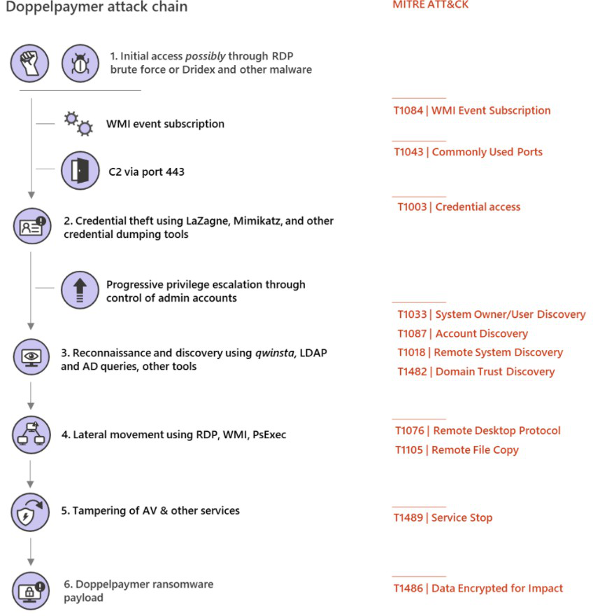
DoppelPaymer Attack Chain
Initial access
Phishing emails
Dridex, RDP brute force
Command and Contorl
Empire script
Privilege Escalation
Credential Access
Discovery
Lateral movement
WMI/SMB,PsExec
Defense Evasion
Execute the ransomware payload
Notes:
右邊的圖是DoppelPaymer的攻擊流程圖，一開始會用phishing email, Dridex或是RDP brute force的方式來達成initial access，然後command and control會用base64-encoded的powershell empire script 連線到C2 server，接著會嘗試獲取更高的權限並且偷倒一些credential，Discovery會ping multiple machines或是看有哪些active的RDP session，然後會用WMI,SMB,PsExec等工具來達成lateral movement並且在ransomware的file自我刪除前會將防毒軟體關掉，最後執行ransomware的payload時會將ransomware的binary偽裝成合法的binary

Slide 6
Attack Emulation
Environment Design
Attack Chain
Attack Flow
Implementation

Slide 7
Environment Design
Victim’s environment design
Router
Zeek
Filebeat
PC
Windows 10
Windows Defender disabled
Microsoft Office
7-zip/WinRAR
Winlogbeat and sysmon
Attacker’s server environment design
Kali Linux
Empire
Notes:
模擬攻擊時victim端會有一台router裡面會安裝zeek跟filebeat，電腦的部分是windows 10，windows defender要關掉，然後會安裝Microsoft Office、解壓縮工具以及winlogbeat跟sysmon來觀察系統的log
attack server的環境是用kali，會在上面安裝empire

Slide 8
Attack Chain
Initial access: phishing email with a malicious attachment
Command and control: empire [1][2][3]
Reverse shell
Privilege Escalation: bypassUAC in empire module
Credential: mimikatz in empire module
Get victim’s NTLM
[1] https://github.com/mishmashclone/BC-SECURITY-Empire
[2]https://null-byte.wonderhowto.com/how-to/use-powershell-empire-getting-started-with-post-exploitation-windows-hosts-0178664/
[3]https://ethicalhackingguru.com/how-to-use-powershell-empire-3-the-powershell-empire-3-tutorial/
Notes:
在我們模擬的攻擊中initial access是利用phishing email的attachment來達成，command and control是利用empire這個工具，連線上後會做reverse shell並且用bypass UAC來獲得管理員權限以及用裡面的mimikatz module來 dump credential
我們只有模擬到Doppelpaymer attack chain的第二步，因為我們希望受害者被攻擊後可以盡早發現

Slide 9
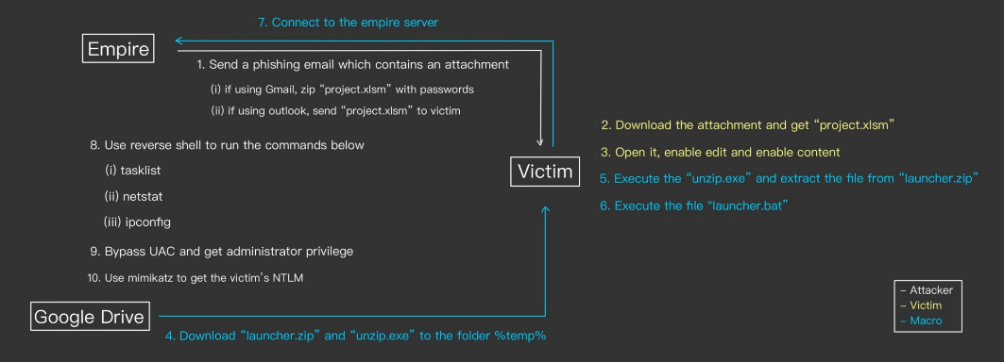
Attack Flow
Notes:
這張是我們模擬攻擊的流程圖，一開始會線透過phishing email來寄malicious attachment給受害者，等受害者執行含有macro的excel文件後會從雲端上下在需要連上attack server的檔案並且執行，連線上後攻擊者會執行reverse shell指令，並利用bypass UAC來獲取管理員權限，最後會用mimikatz 這個module獲得受害者的NTLM

Slide 10
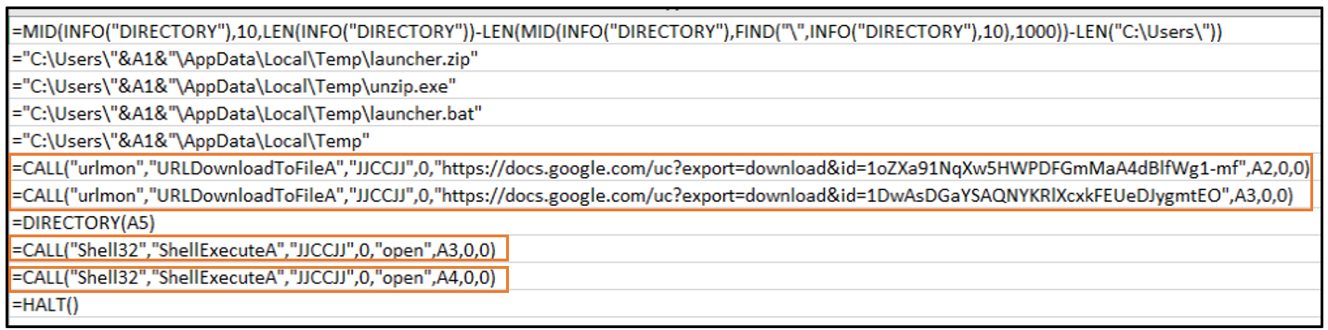
Implementation of Malicious File
Using excel 4.0 macro(XLM) [4] [5] [6]
Download “launcher.zip” and “unzip.exe” from Google Drive
Execute “unzip.exe” to extract the file “launcher.bat” from “launcher.zip”
Execute “launcher.bat” to connect to attacker’s server
[4]https://d13ot9o61jdzpp.cloudfront.net/files/Excel%204.0%20Macro%20Functions%20Reference.pdf
[5]https://stackoverflow.com/questions/6934169/how-to-show-current-user-name-in-a-cell
[6]https://vblocalhost.com/uploads/VB2020-61.pdf
Notes:
含有macro的office文件是為了下在需要連上attack server 的檔案，這裡是用XLM macro來達成，第一個框起來的部分是從雲端上下載壓縮檔launcher.zip以及解壓縮工具unzip.exe ， 地案個框起來的部分是執行unzip.exe之後會的到真正連上attack server 的檔案launcher.bat，最後在執行launcher.bat

Slide 11
Implementation of C&C
After executing “launcher.bat”, the victim connect to attacker’s server
Reverse shell
tasklist
netstat
ipconfig
Notes:
連線上後attacker可以看到有人連線上了，之後會執行reverse shell 的command，有tasklist, netstat以及ipconfig

Slide 12
Implementation of Privilege Escalation
Use module privesc/bypassuac to get admin privilege
Notes:
接下來會用bypassuac來獲取管理員權限，在圖中框起來的部分可以看到第二個得最左邊有個*，代表或的管理員權限，

Slide 13
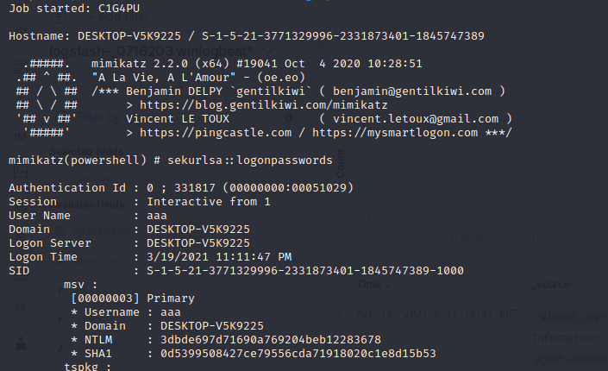
Implementation of Credential Dumping
Use mimikatz to get the NTLM
Notes:
接下來會用mimikatz來獲取受害者的NTLM

Slide 14
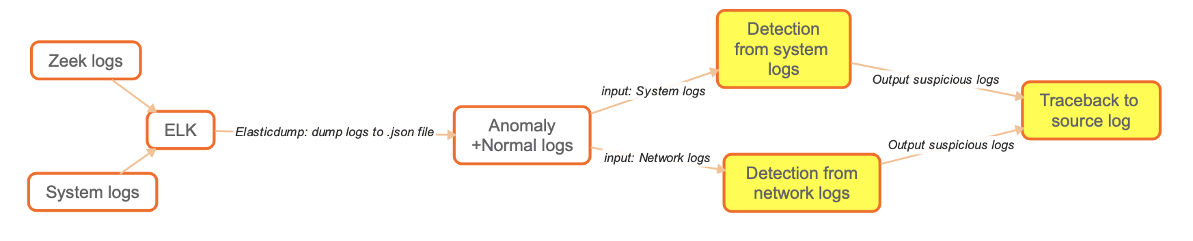
Framework Overview
Notes:
這是我們專題的架構圖，首先，we will upload attack+normal 產生的zeek log and systemlog to elk,再把log從ELK上dump下來，log有兩種分別是system log and network log,system log 有 sysmon, windows-security, 和powershell 的log network則是zeek的log, 兩種log會分別送到兩個model,finally, the models will send suspicious log to traceback to source log

Slide 15
Detection from System Logs
Objective
Field Selection
Machine learning algorithm
Detection Model
Improving recall
Combining two results

Slide 16
Objective of System-log-based Detection
Collect system logs of Windows Security Logs and Sysmon
Goal: Detect the attack by analyzing system logs with machine learning
Notes:
系統活動的異常檢測使用到Windows Security Logs和Sysmon的logs，目標是用機器學習來從這些log偵測出攻擊產生的log。

Slide 17
Fields Selection of System-log-based Detection
Certain fields of system logs contain significant information of various events
_source.process.command_line
Downloading the malicious file
Execution of files of commands (ipconfig, netstat, tasklist, etc)
_source.file.name
The malicious excel file and its Zone.Identifier
unzip.exe
launcher.bat
Notes:
我選擇的field是_source.process.command_line和_source.file.name，前者可以看出下載惡意檔案和執行指令的部分，後者可以看到惡意檔案和它的Zone.Identifier, unzip.exe和launcher.bat等和攻擊相關的檔案。

Slide 18
Machine Learning Algorithm of System-log-based Detection
Supervised - requires labels
SVM
Works well when the separation of data classes is clear
Small dataset for training
memory efficient
Unsupervised - does not require labels
Isolation Forest
Simple for training
Fast
Requires less memory
One-class SVM
Similar to SVM
But only one class (normal logs)
Notes:
我使用了不同種類的machine learning model來偵測異常log，分別有supervised和unsupervised。supervised machine learning model需要label，我選擇SVM的原因是它在資料分類清楚時表現良好，可以用較小的dataset來train，而且比其他model更具有memory efficient的特性。Unsupervised machine learning不需要label，我測試了Isolation Forest 和One-class SVM，前者training方式簡單，而且有快速和需要較少memory的優點。One-class SVM和SVM原理類似，差別在只需要一個class，對應到正常的log。

Slide 19
Model of System-log-based Detection
Use TF-IDF Vectorizer for string processing
Tune a machine learning model
Use make_pipeline for combination
Test with unknown logs
Notes:
因為log的內容不能直接輸入機器學習的模型中，所以先經過TF-IDF Vectorizer進行字串處理。接下來會tune一個machine learning的model。將這兩部分用make_pipeline串起來後，用label好的log來train，存好model後可以測試未知的log。

Slide 20
Improving Recall of System-log-based Detection
After getting the result from the predict function
Use a list to store the pid of each log which is considered to be an anomaly and has pid
Check the pid of every log in the testing dataset and set the result to ‘anomaly’ if that pid is in the list
The number of false negatives is reduced
Notes:
為了提高偵測結果的recall值，也就是異常log被偵測出來的比例，除了沒有pid的log外，我將被偵測出的log的pid存到一個list中，接下來檢查所有log，只要pid在這個list中就將它標為anomaly，如此一來false negative會降低。

Slide 21
Combining Two Results of System-log-based Detection
The results of detecting _source.process.command_line and _source.file.name may reflect different parts of the attack
Therefore, use the union of the logs which are considered to be anomalies by testing each of the two fields to decide the final results
Notes:
兩個field的偵測結果可能涵蓋不同面向的攻擊，所以我用取聯集的方式結合這兩個結果。

Slide 22
Detection from Network Logs
Objective
Field Selection
Maching learning algorithm
Notes:
接下來會講關於network log的偵測，總共分成三個部分，分別是objective, field seleciton, maching learning algorithm

Slide 23
Objective of Network-log-based Detection
Use zeek to monitor network traffic
Use connection log to do anomaly detection
Idea: When the attack was launched, it may cause abnormal network traffic
Notes:
在Network traffic的部分是用zeek來觀察，會用connection的log來做anomaly detection，想法是當受害者被攻擊時可能會產生一些不正常的network traffic，像是需要從遠端攻擊者的sever中下載一些malicious file，這可能會造成短時間內有大量的network flow，我們想要偵測到像是這種行為的 log

Slide 24
Fields Selection of Network-log-based Detection
duration: how long the connection lasted
orig_bytes: the number of payload bytes the originator sent
resp_bytes: the number of payload bytes the responder sent
orig_ip_bytes: number of IP level bytes that the originator sent
resp_pkts: number of packets that the responder sent
resp_ip_bytes: number of IP level bytes that the responder sent
id_resp_p: responding endpoint’s TCP/UDP port
Notes:
在network detection時做的時候選擇的field是跟packet流量有關的所有field以及response port，response port 是為了看有沒有開啟一些平常不會用到的port

Slide 25
Machine Learning Algorithms of Network-log-based Detection
Isolation Forest
PCA
Easy to get training data from one class
Difficult to get sufficient samples of the targeted anomalies
HBOS
A suitable option for treating global outlier
FeatureBagging
Use combination methods to improve the predictive accuracy and control over-fitting
LSCP
Selectively combine base detectors by emphasizing data locality.
Notes:
在選擇machine learning的algorithm時，isolation forest, pca, hbos, featurebagging以及lscp是train的比較好的model，ioslation forest就跟前面提到過的一樣，pca是比較容易從某個類別取得定型資料的情況下建立模型，但很難取得足夠的目標異常樣本
HBOS是會假設每個feature是independent的，藉由建立直方圖來計算邊緣的程度，可以容易的偵測到global outlier
因為anomaly detection中normal與attack的比例懸殊很大所以可能會造成很高的false alarm所以會透過結合model來降低false alarm
分別有FeatureBagging以及LSCP

Slide 26
Log Traceback
Objective
Process
Implementation
Database structure schema
Use database to store logs and do querying
Use graphviz to create relationship graph
Notes:
這是log traceback 的架構，首先會介紹traceback的目的, 再介紹traceback 的流程，最後會介紹實作方法

Slide 27
Objective of Log Traceback
Goal:
Traceback to the email link or attachment rule from suspicious logs
Other function
Find out all the logs produced during the attack
Visualize the detection result
Notes:
Traceback的目的是找到攻擊源頭的log,也就是能證明attack 是從phishing email 而來的log,除了traceback本身，log traceback 這個部分也可以找出攻擊鏈裡的所有log並把攻擊練視覺化。

Slide 28
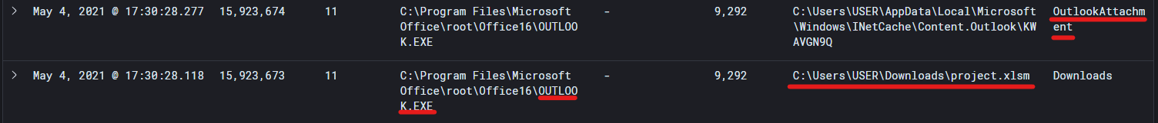
Process of Log Traceback
Both network and system detection will return logs they consider anomaly
Find the parent of the suspicious log and continue to do so
Once trace to the oldest log, find out the log (event id 11 or 15) with identical executables argument and use the content/rule_name of the log to prove it indeed come from phishing email
The rulename indicates that the .xlsm file is outlook attachment
The content shows that the file is email attachment
Notes:
我來講解一下traceback到source log的流程：首先，traceback 會先收到network detection 和system detection 覺得可疑的log,然後traceback會找到可疑log的父母，在找其父母的父母，直到不能再找為止。這時，尋找process.executable 能和該log match 的log，並找出能證明suspicious log 的源頭是email 的log.

Slide 29
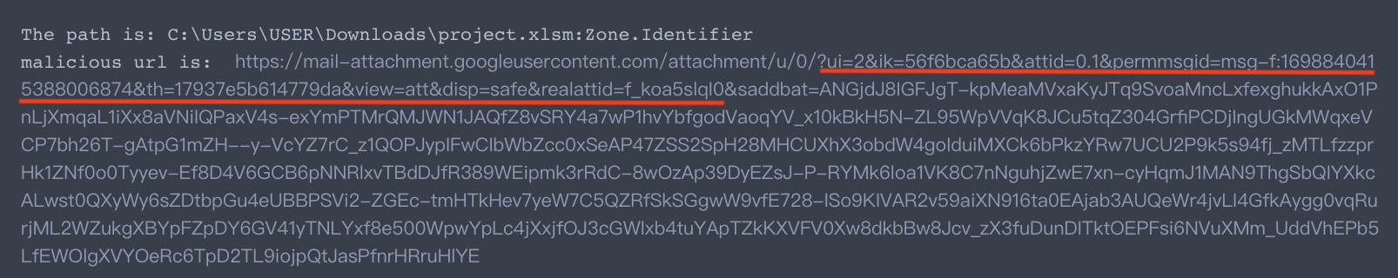
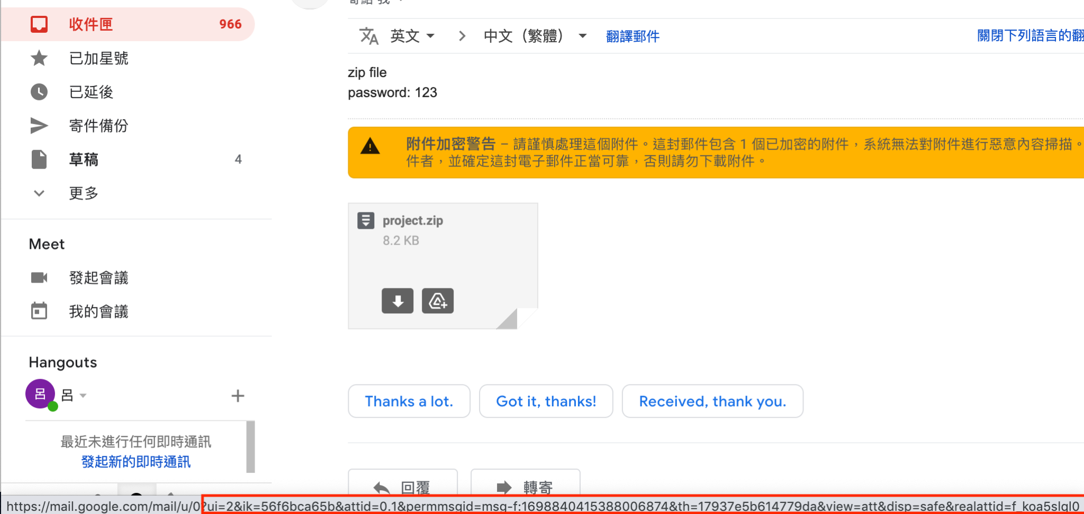
How to Know Malicious URL Comes from Email
The url of the filestream log (event id 15) match with that of the phishing email
The url of the filestream log
The url of the phishing email with attachment
Notes:
要如何知道找出來的log真的是email的log?上圖是traceback 找到的malicious url,他在log的content裡面，那個url 跟phishing email的url 是對的起來的，可以從圖片匡來的地方看出來。

Slide 30
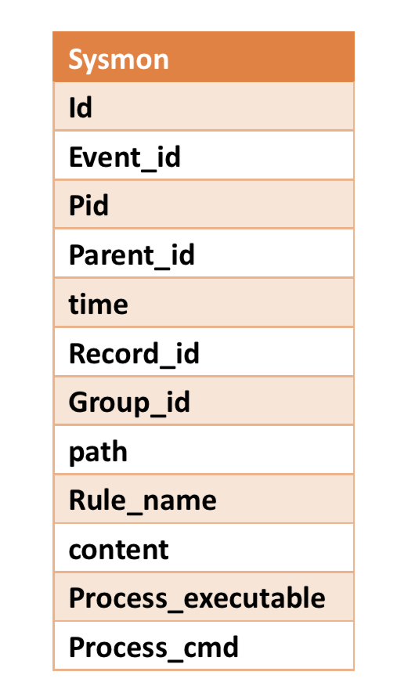
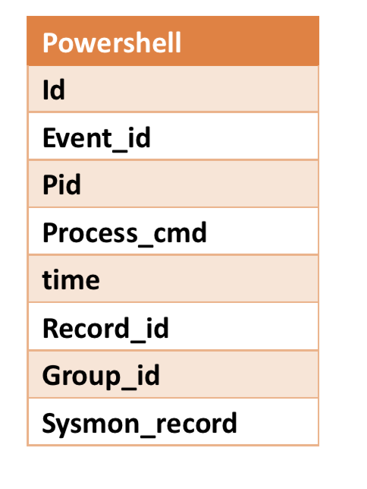
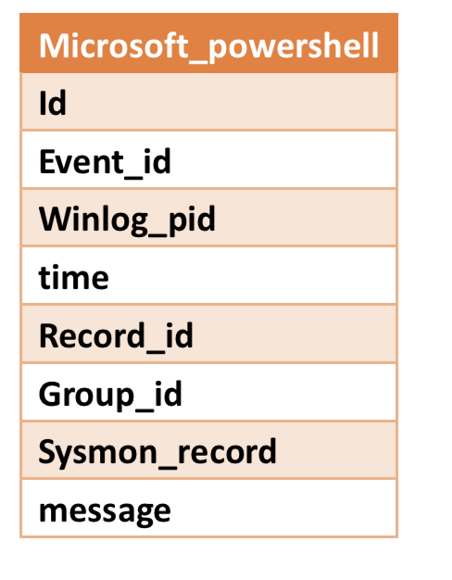
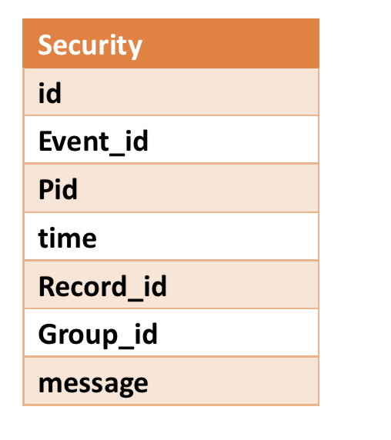
Database Structure Schema of Log Traceback
Use database and Python dictionary to store the necessary information
Create 4 tables depends on provider of the log
Sysmon
Windows-Security log
Powershell logs *2
Why database?
Easier to manage
Effective
Notes:
接下介紹的資料庫的設計：
1.根據log provider 種類分4 tables
2.rulename content,process_executable,process_cmd 存traceback source的
3. powershell log 沒有record id, 和sysmon_record 對
選擇database的原因是因為database比較好管理log的資料，再做查詢和更新資料這方面有效率

Slide 31
Implementation Method of Tracing back to source log
Traceback to source log
Use Sysmon log to chain the related log
Sysmon log with event_id 1 has parent.pid, which indicates the relationship between logs
The relationship between logs is recorded in a dictionary
Query all the possible candidates of source log and find the one whose executable arguments match with oldest log with event_id1
Extract the log’s content or rulename
Notes:
接下來要介紹找到攻擊源頭的log的實作,首先，sysmon event_id 1的log有一個field parent.pid,顯示log 之間的關係,所以用 event-id =1 的log把log process.pid 之間的關係存好，當input進來後藉由這個特性traceback 到最老的event_id 1 的log,接著利用資料庫找到可能的source log(email log)

Slide 32
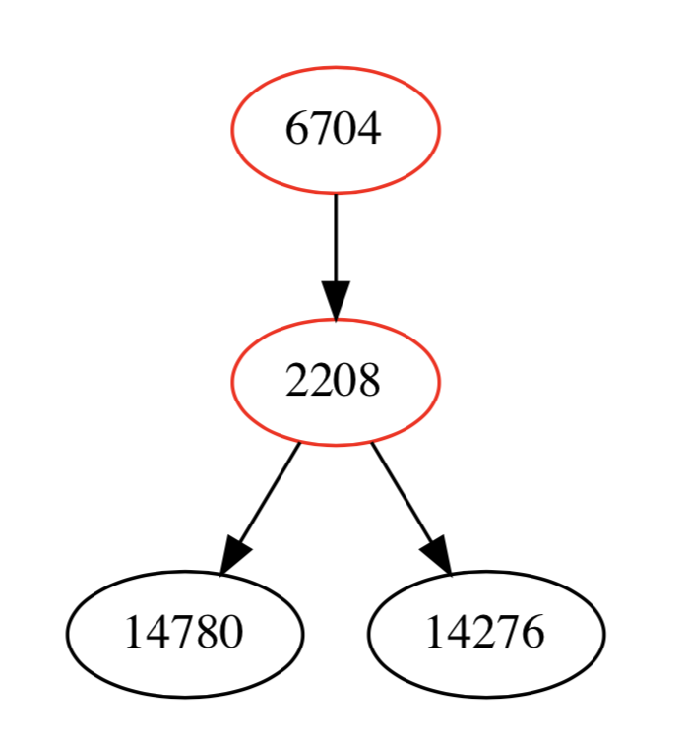
Implementation Method of Finding All Attack Logs
The relationship between logs is recorded in a dictionary
Find all the descendent logs of the source log (sysmon event_id 1)
Use querying to find all the other logs with identical process.pid
Update the group_id of each log
the logs with identical group_id as the source logs are anomaly logs
Write dot language simultaneously to visualize the outcome
The graph at the right side is the attack tree with detection result
red: detected, black: not detected
Notes:
找到所有log的部分實作，是從source log 開始往下trace,並用query 找到其他有相同pid 的log,而這些log涵蓋sysmon security and powershell
接下來update所有log的group_id,有和source log相同group id 的log 就是anomaly log, 而在找log的同時, 也會同時寫dot language 來記錄log 的關係，log 找完後，圖也回隨後出現，右邊那張圖就是把所有process.pid 串再一起的範例，紅色的部分是有被detect 到的log，黑色的部分則沒被偵測到

Slide 33
Evaluation of System-log-based Detection
 | Accuracy | Precision | Recall | F1
Isolation Forest | 0.992614 | 0.542029 | 0.907767 | 0.678766
One-class SVM | 0.992614 | 0.542029 | 0.907767 | 0.678766
SVM (C=1.0) | 0.998957 | 0.964103 | 0.912621 | 0.937656
SVM (C=10) | 0.999583 | 0.966667 | 0.985437 | 0.975962
Notes:
這是不同model偵測系統log的performance，我使用Isolation Forest和One-class SVM這兩種unsupervised machine learning時，結果有較高的false alarm，因此precision較低。使用SVM這種supervised machine learning的model來訓練label好的log可以有較低的false alarm，改善performance，而調整SVM的參數也會影響結果，由表格可看出C=10的表現較好。

Slide 34
Evaluation of Network-log-based Detection
 | Accuracy | Precision | Recall | F1
isolation forest | 0.984195 | 0.2071005 | 0.985915 | 0.342298
PCA | 0.997884 | 0.997884 | 0.985915 | 0.795454
HBOS | 0.855002 | 0.02759164 | 0.985915 | 0.0536809
FeatureBagging | 0.999353 | 0.875 | 0.985915 | 0.927152
LSCP | 0.999353 | 0.875 | 0.985915 | 0.927152
Notes:
這是不同model下測試的network logs，最後發現在不同dataset下FeatureBagging跟LSCP的結果最好也最穩定，但因為執行速度上FeatureBagging比LSCP快很多，所以最後選擇用FeatureBagging

Slide 35
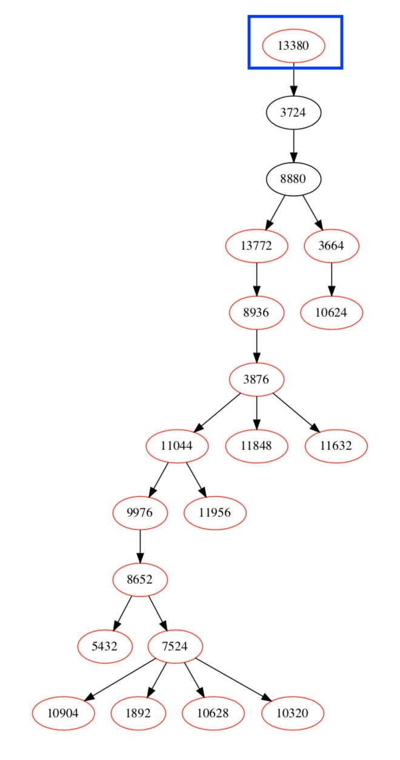
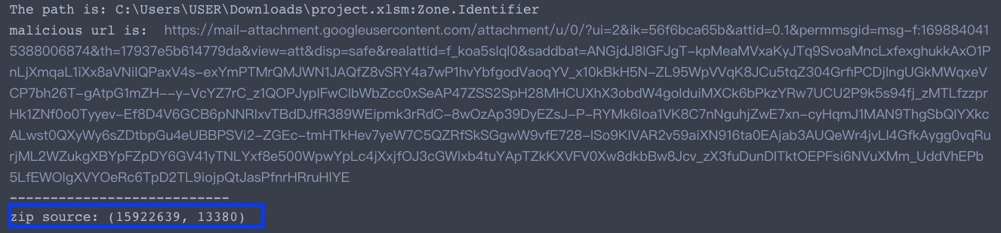
Evaluation of Traceback
Malicious url can be found by our method as the picture shown below
The attack tree can be generated after traceback
Notes:
以下是log traceback evaluation 的結果：
我們可以透過traceback 找到 malicious url(桃紅色匡起來的地方)
attack chain can be generated after traceback
藍色框是源頭

Slide 36
Conclusion & Contribution
Conclusion
Best model for anomaly system log detection is SVM
Best method for anomaly network log detection is Histogram-based Outlier Detection + FeatureBagging
Using sysmon log’s pid to do traceback and find all attack logs are feasible
Contribution
Interpret the attack in both system and network aspects, most of the related works only focus on one of them
Provide a novel framework to do anomaly detection of attack launched by DoppelPaymer
Find out all the logs produced during the attack, which can help us know more about the overall attack
Notes:
做完了專題，我們得到三個結論
anomaly system log detection 效果最好的model 是 svm
anomaly network log detection 效果最好的model 是feature bagging with its base detector HBOS
用sysmon log pid parent pid 來做traceback找到source log 及所有的log 是可行的
而以下是我們的貢獻：
anomaly detection 在system network 兩方面都有著手，大部分的related work 都只做一種
提供新的framework 偵測doppelpaymer 的攻擊
找出所有log,更加了解攻擊的全貌及手法

Slide 37
Thanks for listening

